Slide 1

Data-Driven Car Price Prediction
An end-to-end analytics and machine learning solution to analyze factors affecting car prices and predict market value using historical data.

Slide 2
Project Objectives
Analyze Key Factors
Structured SQL Analysis
Interactive Power BI
Understand what drives car prices.
Perform in-depth data analysis using SQL.
Create a dashboard for actionable business insights.
Data-Driven Decisions
Enable informed choices in the automotive domain.

Slide 3

End-to-End Workflow: Data Collection
Our project begins with comprehensive data collection, gathering historical car listings with crucial attributes to build a robust dataset for analysis and prediction.
Brand & Model
Year of Manufacture
Mileage
Fuel Type
Transmission
Engine Capacity
Selling Price

Slide 4
Data Cleaning & Preprocessing
01
02
03
Remove Duplicates
Handle Missing Values
Standardize Values
Ensuring data integrity by eliminating redundant records.
Addressing gaps in the dataset for complete analysis.
Uniforming categorical data for consistent processing.
04
05
Convert Data Types
Feature Engineering
Optimizing data formats for efficient analysis.
Creating new features like car age and price per km.

Slide 5
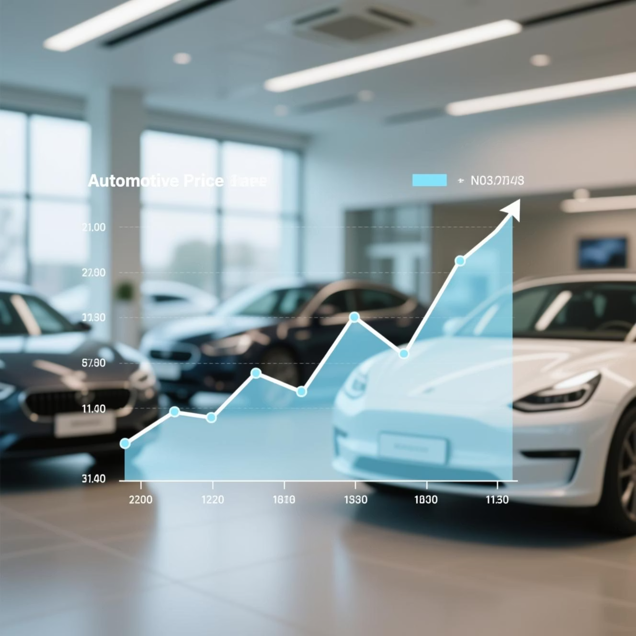
Exploratory Data Analysis (EDA)
EDA reveals underlying patterns and insights, helping us understand price distributions and key relationships within the car market.
Price distribution analysis
Price vs. Year, Mileage, Fuel Type
Brand-wise and model-wise comparisons
Outlier detection

Slide 6
SQL Analysis: Structured Insights
1
2
Table Creation
Count Total Cars
Structuring raw data into organized tables.
Determining the overall size of our dataset.
3
4
Price Metrics
Popular Brands
Calculating average, min, and max prices.
Identifying top-selling and most common car brands.
5
6
Fuel & Transmission Trends
Car Ranking
Analyzing preferences in car specifications.
Ordering cars by price and mileage for comparison.

Slide 7
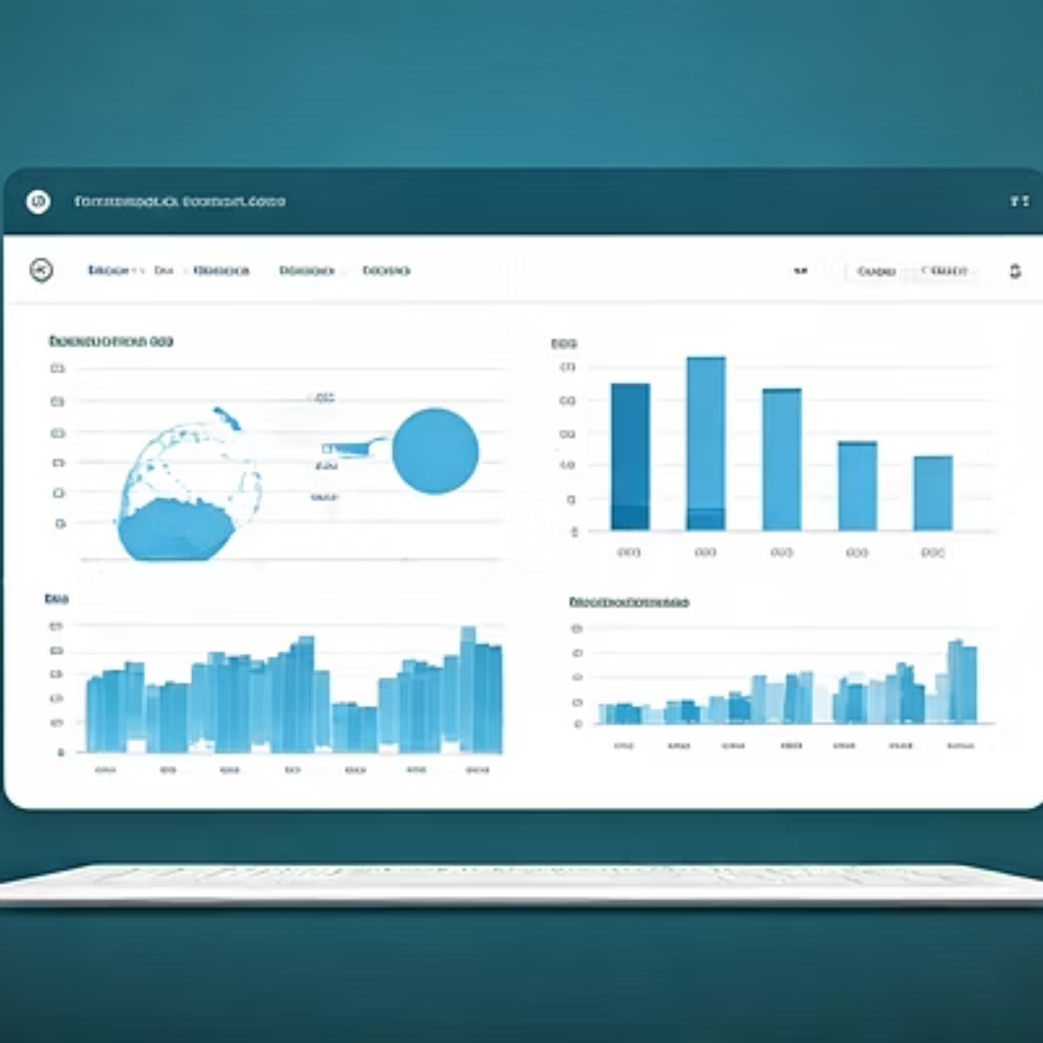
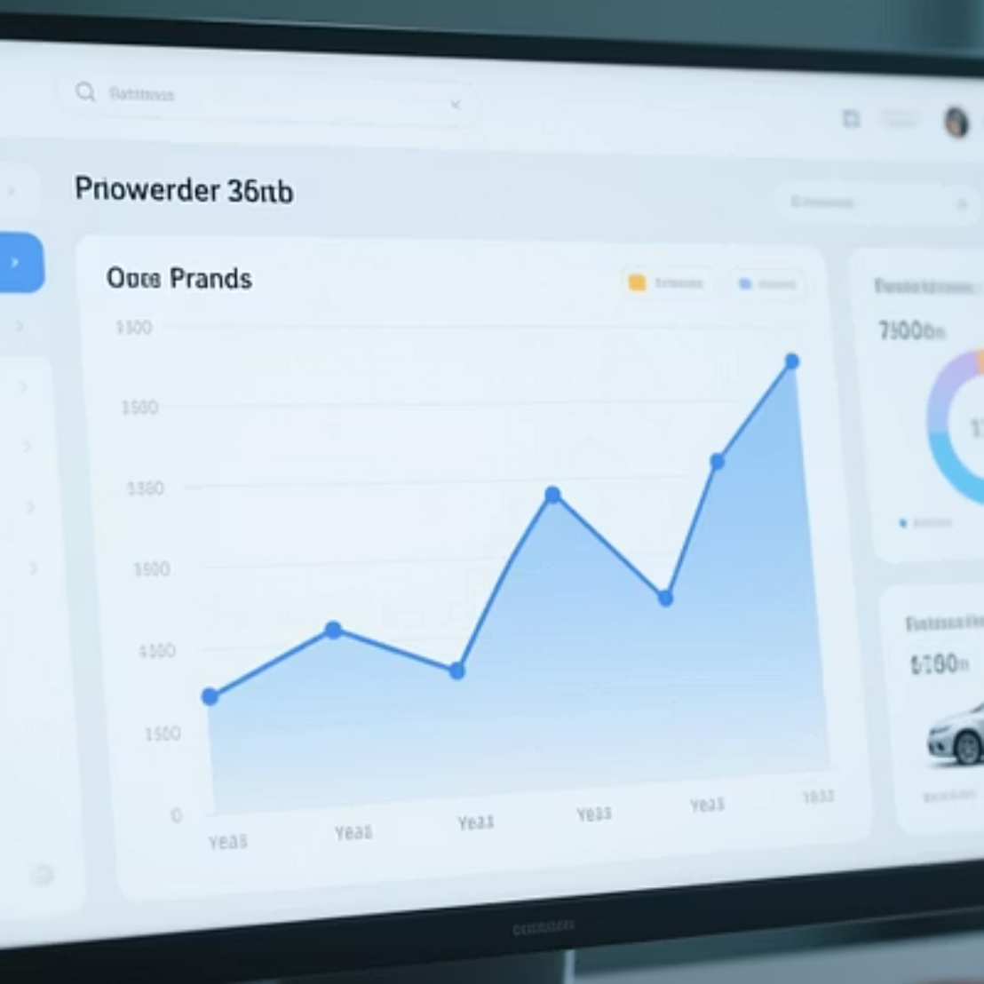
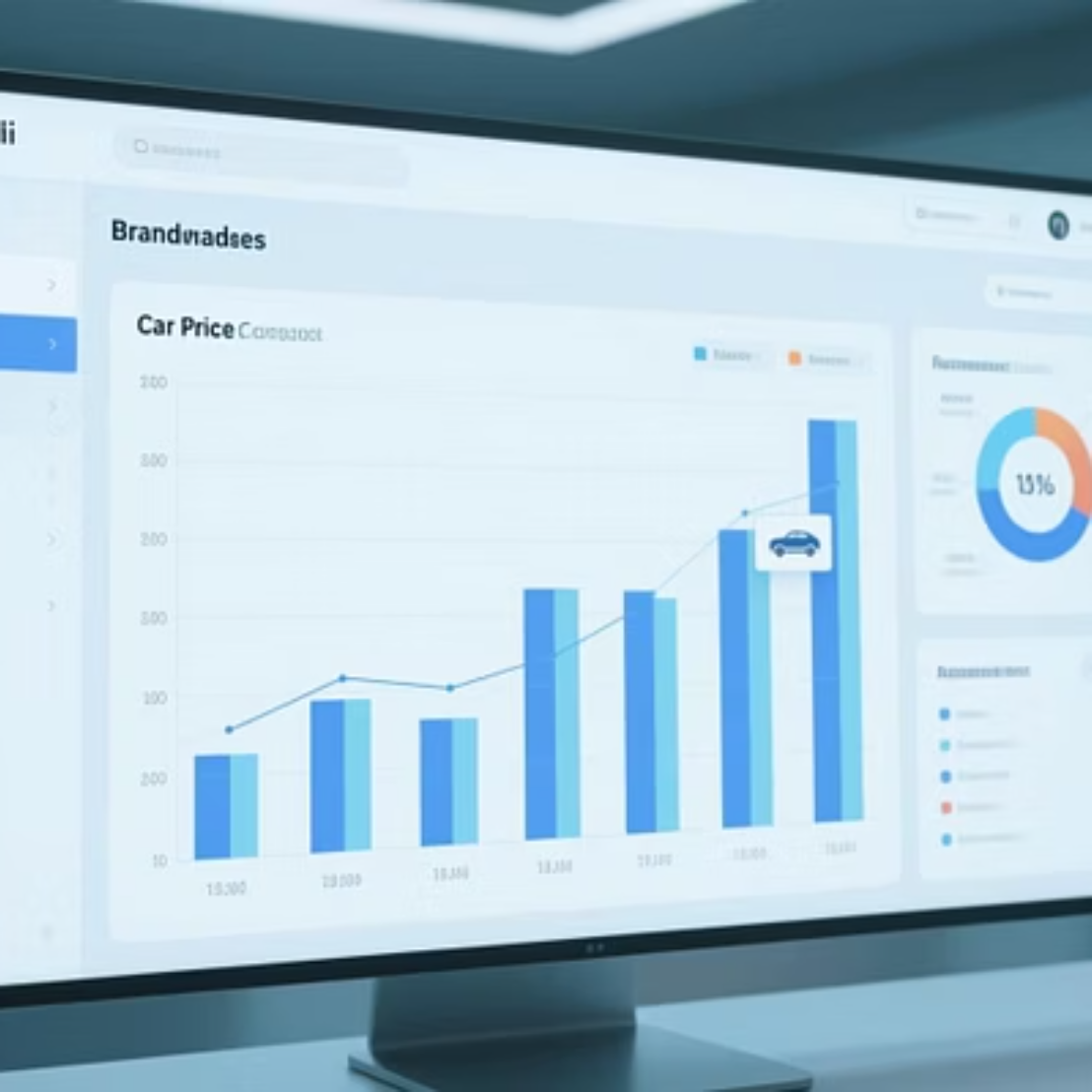
Power BI Dashboard: Interactive Insights
Our interactive Power BI dashboard provides a dynamic view of car market trends, enabling users to explore data and make informed decisions.

Slide 8
Key Dataset Insights
2501
7
28
52638
Total Cars
Total Brands
Total Models
Avg. Price (₹)
Comprehensive dataset size.
Diversity of manufacturers.
Variety of car types.
Mean market value.
5011
99982
Min. Price (₹)
Max. Price (₹)
Lowest recorded price.
Highest recorded price.

Slide 9


Empowering Automotive Decisions
This project delivers a powerful tool for buyers, sellers, and dealerships to navigate the complex car market with confidence and precision.
Buyers
Sellers
Informed purchasing decisions.
Optimized pricing strategies.
Dealerships
Enhanced market understanding.

